Slide 1



Methodologies for Determining Student Performance Risk
Robert Cilino, M.B.A. – Independent Researcher
Mohammadreza Shojaei Kol Kachi, M.S. – Keuka College
Special Thanks to Dr. Carol Lugg
NEAIR Conference 2024 – Newport, RI

Slide 2
About Us
Robert Cilino
Prev. Keuka College – Asst. Dir. Of Institutional Research 2018-2024
Methodologies developed with Mo at Keuka College
Currently interim Institutional Researcher at Alfred University
Head Coach, Alpine Skiing – Alfred University
B.S., M.B.A. - Alfred University
Mohammadreza Shojaei Kol Kachi – “Mo”
Retention Data Analyst – Keuka College
B.S. Industrial Engineering - Iran University of Science and Technology
M.S. Data Science – Rochester Institute of Technology
Methodologies for Determining Student Performance Risk

Slide 3
What is Performance? What is Risk?
Performance:
Dependent Variable
Retention or Persistence
Graduation
Term or Cumulative GPA
Whatever you want it to be
Risk Factors:
Independent Variable
Anything you can think of! (that you have data for)
Brainstorm, be creative, don’t get stuck placing preconceptions on any data point before testing them
Methodologies for Determining Student Performance Risk

Slide 4
Are there any concerns?
This should NOT be used to exclude certain applicants or become more selective
This should ONLY be used to understand our students and their needs, and to help those who really need it
The later outcomes should show that we have the power to identify these “at-risk” students
We need to use that power responsibly to support those students instead of excluding them at the outset
There are so many personal affects involved that we may not be able to get to a perfect model, but don’t let that stop us from making one that still works
Methodologies for Determining Student Performance Risk

Slide 5
How difficult is this?
It is as difficult as you need it to be
It is as scientific as you need it to be, or have time for, or have the abilities/skills for right now
You can always learn them! ☺
If you’re using a tool, just use the tool
I got worried about doing correlation coefficients for binary/point-Biserial comparisons instead of Phi coefficient
Guess what – Excel and Python’s features spit out the same values for both! – Excel: correl(), Python: corr()
I ran fully-qualified Phi coefficient value formulas in Excel, Excel’s correl() formula came out the same as Phi coefficients for binary comparisons
Φ = (AD-BC) / √(A+B)(C+D)(A+C)(B+D)
Methodologies for Determining Student Performance Risk

Slide 6
How can we determine risk factors?
Comparing performance metrics directly in a data table
Easy, but need to be mindful of those with smaller N’s
Comparing performance metrics in charts
Visual, easier for some to comprehend
Data needs to be structured in a specific manner
Can point out smaller N’s as data label
Correlation Coefficients
More difficult
Can be done with many tools – Excel, Python, R, Stata, etc.
All 3?
Used in different ways, helps solidify our understanding of the data
Methodologies for Determining Student Performance Risk

Slide 7

Caveats of this presentation
I am no longer employed at Keuka College, Mo could not attend
We are talking in hypotheticals and examples
Any data shown is either fictional,
or using a free Kaggle dataset
IBM HR Analytics Employee Attrition & Performance
https://www.kaggle.com/datasets/pavansubhasht/ibm-hr-analytics-attrition-dataset
Fictional dataset created by IBM data scientists
Find the IBM Dataset Here!
Methodologies for Determining Student Performance Risk

Slide 8
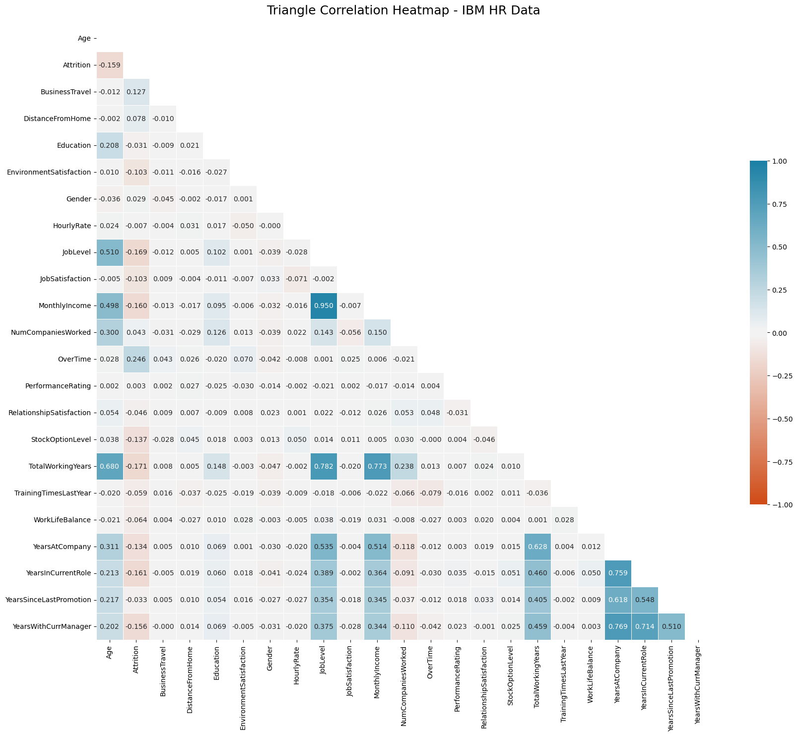
Method #1 – Correlation Matrix/Heatmap
Correlation matrix/heatmap - python
Helps point out relationships to investigate
Not just for DV > IV relationships but, say, “do the students that enroll with higher HS GPAs tend to be of a certain gender, race/ethnicity, town/county or rural/urban area? (RUCA Classification)”
Can be done in Excel as well, in a different manner
If tracking, say, retention over time data can be organized in different timeframes
Ex. 2015-2019, 2019-2023
This can be used to find single-year anomalies
Methodologies for Determining Student Performance Risk

Slide 9
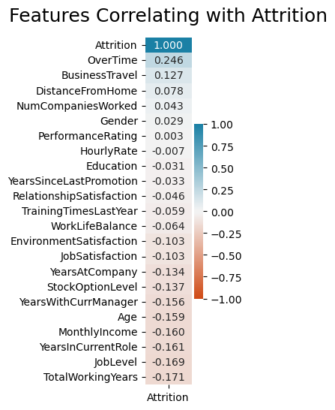

Method #1 – Correlations on Specific IVs
Look directly at our performance variable
This helps reduce the clutter of the large all-encompassing matrix
Students can withdraw for many reasons, many of which cannot be measured.
Find the python notebook here!
Methodologies for Determining Student Performance Risk

Slide 10
Handling Continuous Variables
Correlations are linear relationships, which some continuous variables don’t match, so:
Break up Continuous variables into categories
HS GPA – 10/100-point bands, 5-point bands
Eventually might find a threshold (above or below a certain value – ex. 85/100 HS GPA or below)
Pre-College Transfer Credits
“College preparation” analogue
10-credit bands, 5-credit bands
Eventually might find a threshold (above or below 1 value)
This is why Hourly Rate doesn’t come out as linearly correlated. Can be shown as individual correlations using Excel or Python.
Methodologies for Determining Student Performance Risk

Slide 11
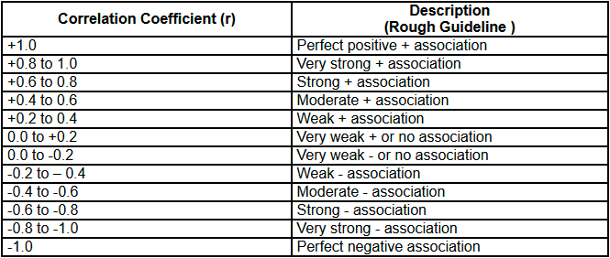
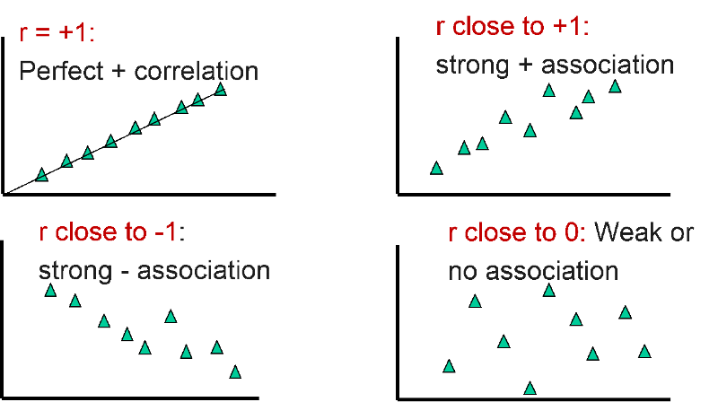
Method #1 - Issues?
But none of our correlations are strong!
These initial correlation coefficients will look as if there is only a weak relationship.
Different fields have different needs
Put many weak relationships together and you might find a strong relationship.
Reframe our scale (later)
This is where comparing the performance metrics directly helps
Retention by Pell and non-Pell, by First-Gen and non-First-Gen, by ranges of High School GPA, etc.
The gaps in retention rates between those subgroups are representations of that correlation
Methodologies for Determining Student Performance Risk

Slide 12
So which students are “at risk”?
Still, none of our correlations are “strong”!
Find what variables has the highest correlation factor to your success measure
Compare against the success measure data directly for those groups
You should see the highest correlation factors have the largest gaps between being “successful” and “not successful”
Reframe our correlation factors!
Say our strongest success measure gap measures a correlation factor of 0.2, reframe our correlation coefficients based on that and create a new scale
Correlation coefficients get smaller when the majority of variables’ values are one way or the other – So retention rates get weaker the better they get and the lower the gap between two independent variables - ex. Athlete vs non-athlete experiencing a ~30 point gap in ret. rates
Methodologies for Determining Student Performance Risk

Slide 13
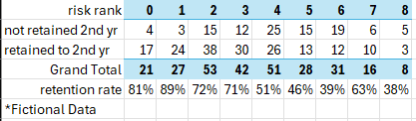
So which students are “at risk”?
Through trial and error we identified our cutoff for “impactful” correlation coefficients
0.05 coefficients seemed to have enough of a measurable impact on retention rates to consider as a “risk factor”
If not using correlations, compare the retention rates of students with different characteristics and look for the largest differences
So, Pell student retention % vs Non-Pell
Data Tables or Charts
Our final ranking methodology got us to maximum 0.32, but a swing of 40% in terms of retention rate for groups of students is significant.
Methodologies for Determining Student Performance Risk

Slide 14
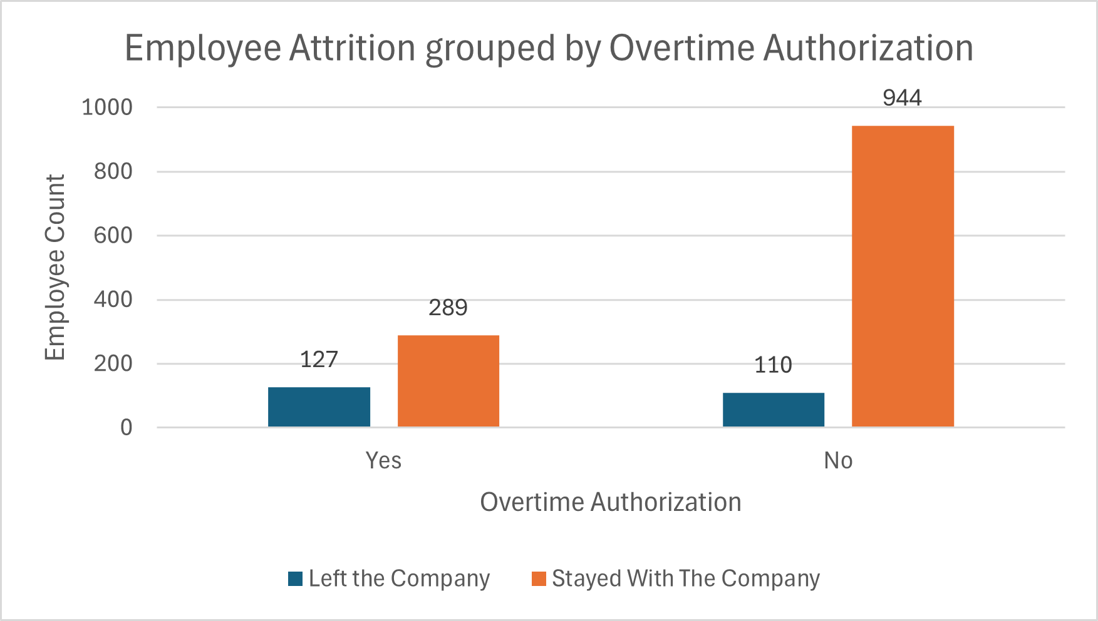
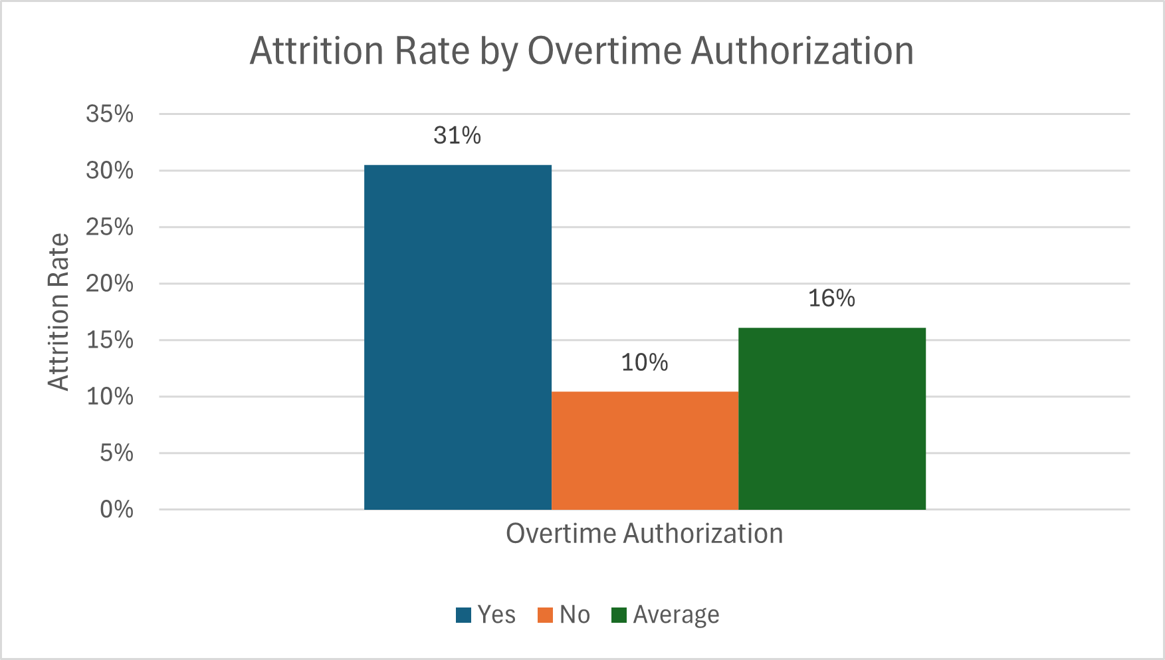
Method #2 – Examining Charts, or examining further
Now that we’ve identified which student characteristics that we want to examine, we can look into them further
Assume the following common examples:
We have less Pell students than non-Pell students
Our Pell students are retained at a much lower rate
Make sure to compare our students to both the average and the opposite subgroup
Methodologies for Determining Student Performance Risk

Slide 15
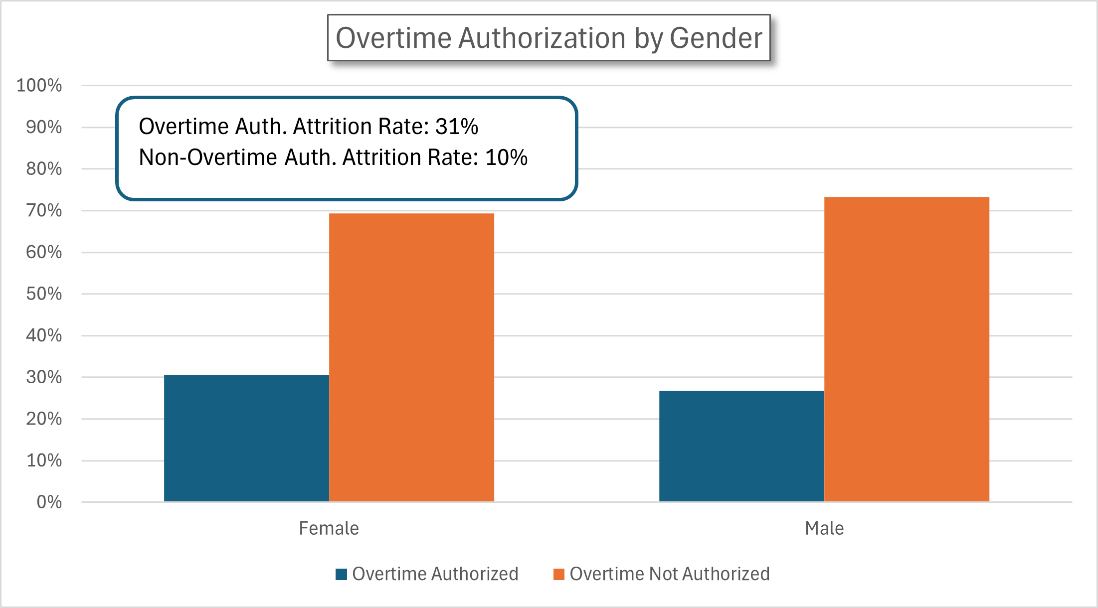
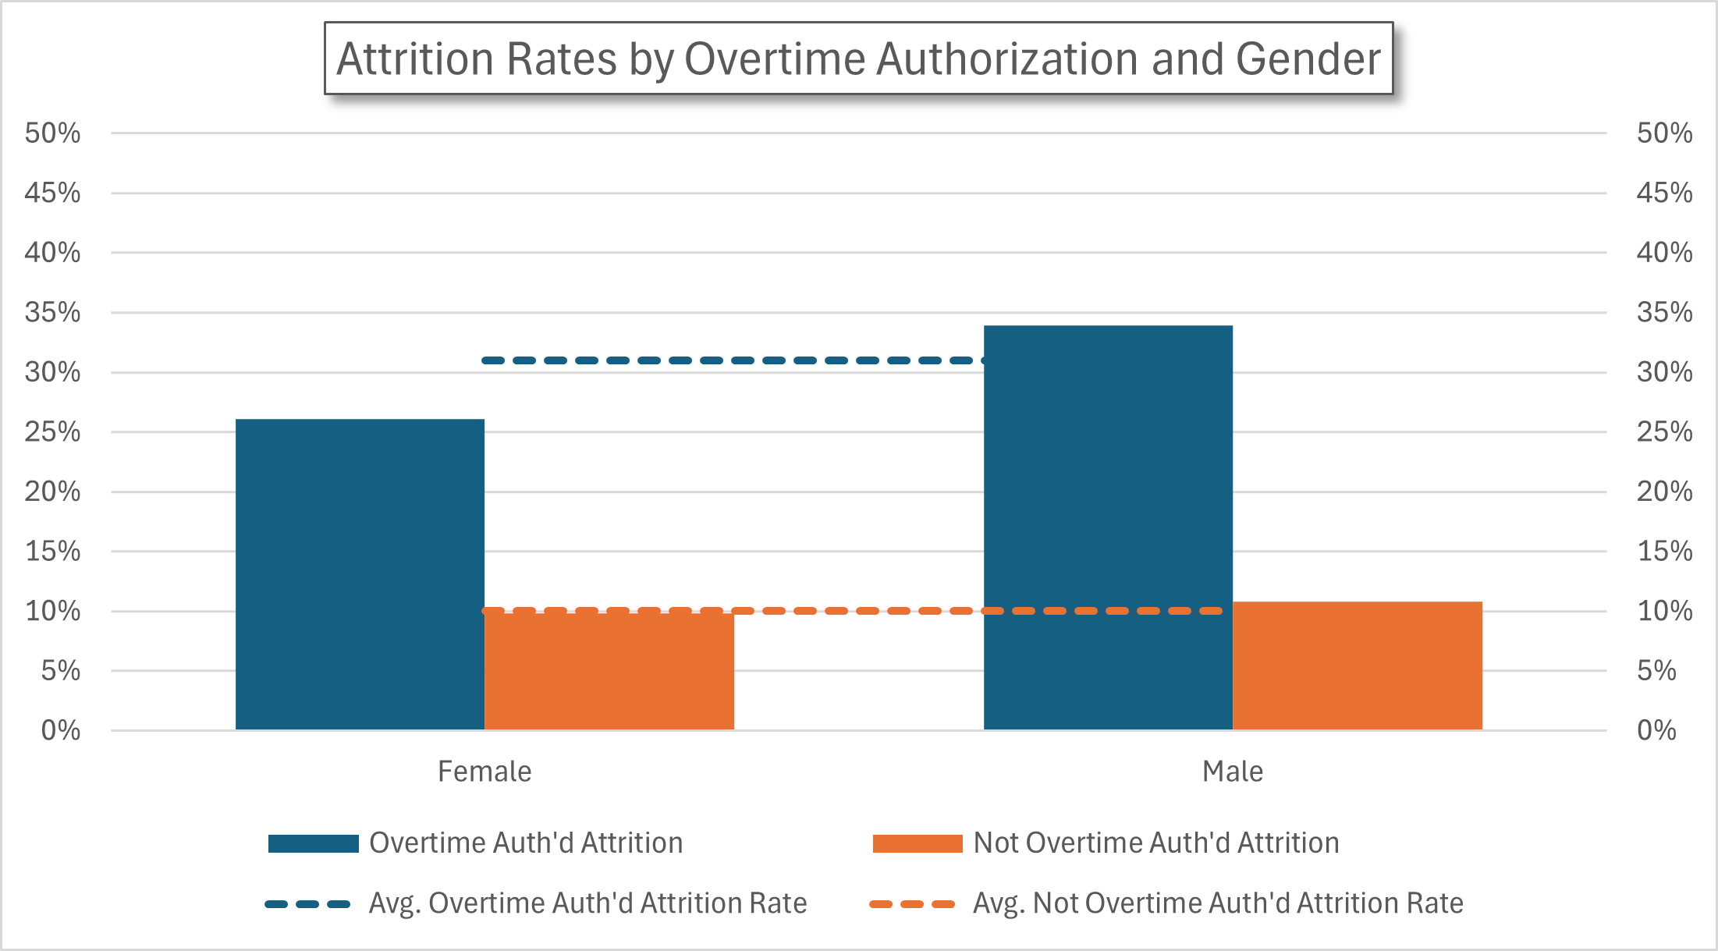
Method #2 – Examining Charts
Generally, athletes in higher ed have higher retention rates, let’s look there in reference to Pell status.
Let’s say our Athletes don’t experience much of a difference when comparing their Pell recipient statuses
But our non-athletes show a great difference.
Later we determined our athletes would not receive the intervention, but we worked with the athletics department so they knew those particular athletes who might need extra attention
*See Appendix for chart setup tips
Methodologies for Determining Student Performance Risk

Slide 16
Method #3 – Comparing Table Data
Use Excel to do the math
Pivot Tables!
Or even just knowing your total and sub-total, then sorting and counting
SQL
SQL is funny, but is more familiar to me
I can add to a table of combined cohort files every year, then easily have SQL do my math for me each year for as many variables as I want to analyze
*See appendix for example SQL query for calculations
Correlations are just “a mutual relationship or connection between two or more things”, so look through the data yourself and find the largest gaps between subgroupings
Pell vs Non-Pell, Athletes vs Non-Athletes, etc.
Find disparities (Athletes 90% avg., non-athletes 60% avg.) then rank by the disparities, you now know which student characteristics have the highest correlation
Methodologies for Determining Student Performance Risk

Slide 17
Ranking our students
Two methods
Create a hierarchy of risk factors, assign risk rankings to each student based on their combination of “risky” characteristics
We had ~15 risk ranks
Count each students’ “risky” characteristics
This doesn’t weigh any particular characteristics as more or less “risky”, but is much easier to perform
We had 9 ranks
We verified each method and found them both fairly accurate
Who we classified as “more at risk” had a lower retention rate, and vice versa
The first year, before we could measure our first impacted cohorts, we retroactively assigned risk ranks to the previous cohort and those student groups tracked the same. Methodology verified!
Notice the anomaly? The model is as complex as you can handle or need it to be, and can be improved with easy complexity. Ex. Analyzing risk factors for your two groups of most disparate students (Athletes, non-athletes) separately and making a ranking “algorithm” for both groups separately.
Methodologies for Determining Student Performance Risk

Slide 18
Applying Interventions
Year 1, because we found athletes had the highest retention rates, we did not apply any interventions to that group – among some other assumptions about the reasons for their success
Year 1 we applied assigned Momentum Advisors to 50 most “at-risk” students
Year 2 the same, plus creating a new intervention that applied to those who were not athletes or the most “at-risk”
Can also calculate Athlete’s risk separately and rank them separately for the most “at-risk” athletes to receive intervention
Methodologies for Determining Student Performance Risk

Slide 19
Intervention Outcomes
In the first year we identified an increase in fall-to-spring retention rates of our students who received Momentum Advising by x%
We also identified an increase in their average GPA by x points
Methodologies for Determining Student Performance Risk

Slide 20

Appendices - Links
Kaggle Dataset – Fictional IBM HR data
https://www.kaggle.com/datasets/pavansubhasht/ibm-hr-analytics-attrition-dataset
Robert Cilino’s GitHub Portfolio
Python Notebook, Presentation
https://github.com/rcilino/Data-Project-Portfolio
Correlation Matrices in Excel
https://www.datacamp.com/tutorial/correlation-matrix-excel
Methodologies for Determining Student Performance Risk

Slide 21
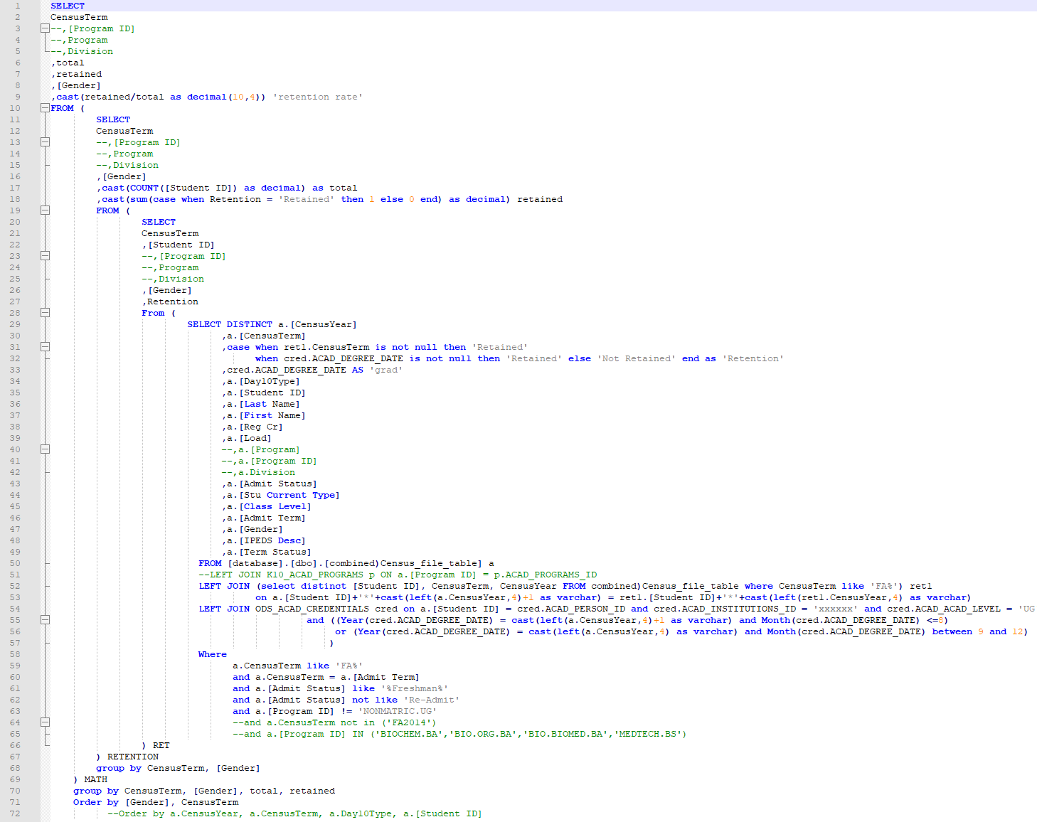
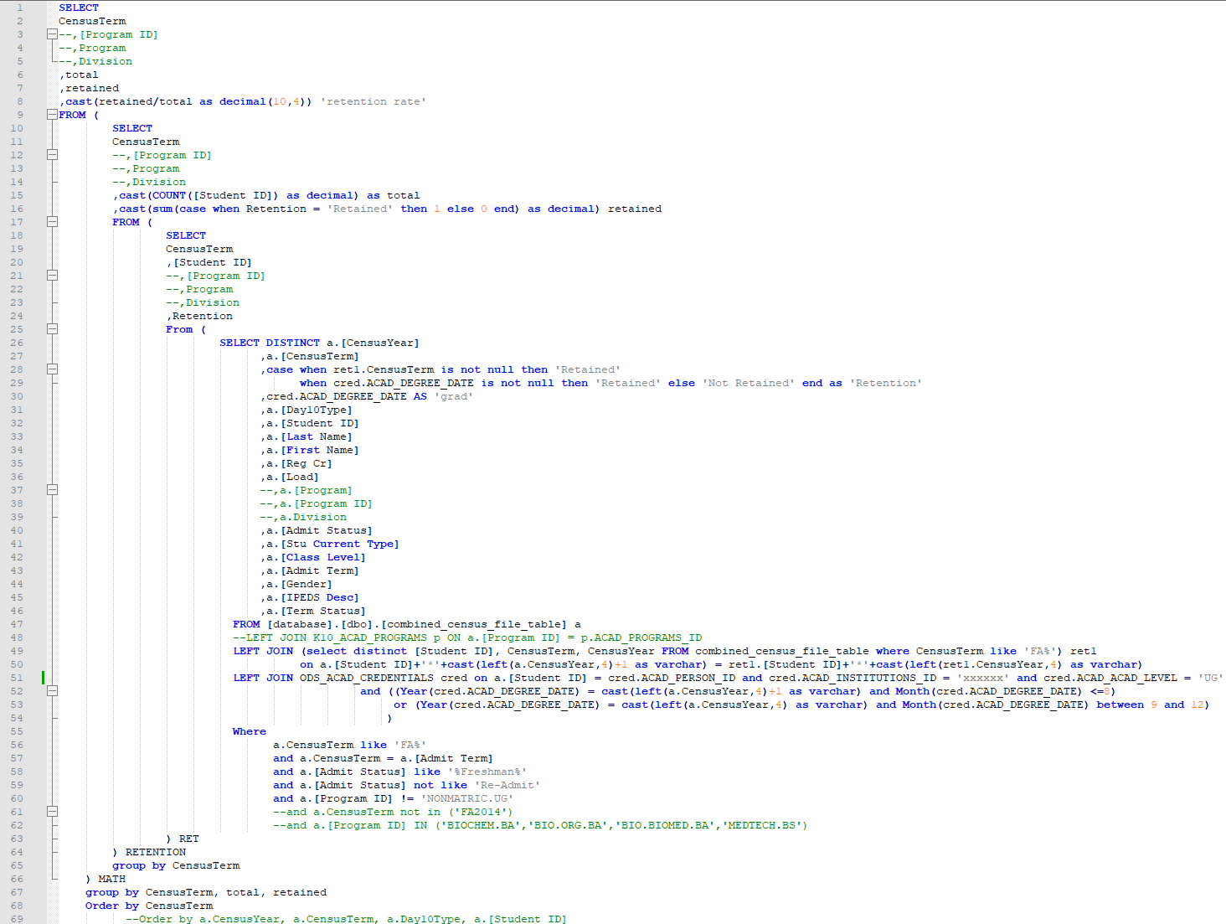
Appendices – SQL Queries for Calculating Retention
*No breakdown/subgroup
*Retention by Gender
Methodologies for Determining Student Performance Risk

Slide 22
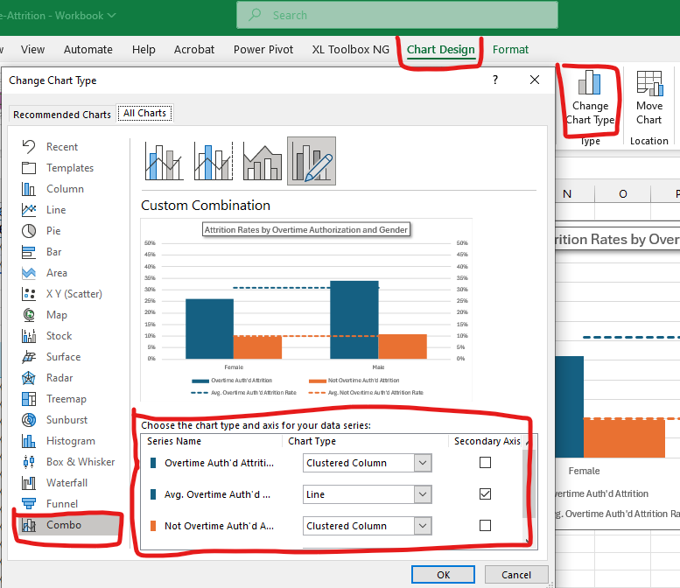
Appendices - How to set up data for Excel Charts
Methodologies for Determining Student Performance Risk

